Slide 1



Prevalence of depressive disorders and treatment in China: a cross-sectional study
Prof. Yueqin Huang, et al
The Sixth Hospital, Peking University

Slide 2












Collaborating centers

Slide 3
Chna Mental Health Survey
Ministry of Health
Ministry of Science and Technology
CMHS

Slide 4
Study contents
Disease Burden of Mental Disorders
Risk factors of Mental Disorders
Prevalence, Disability, and Estimated Incidence of Mental Disorders
Mental Health Service use

Slide 5
Subjects
28,140 community residents
Inclusion criteria
Chinese citizen aged 18 and over
Living in the residential area over 6 months

Slide 6
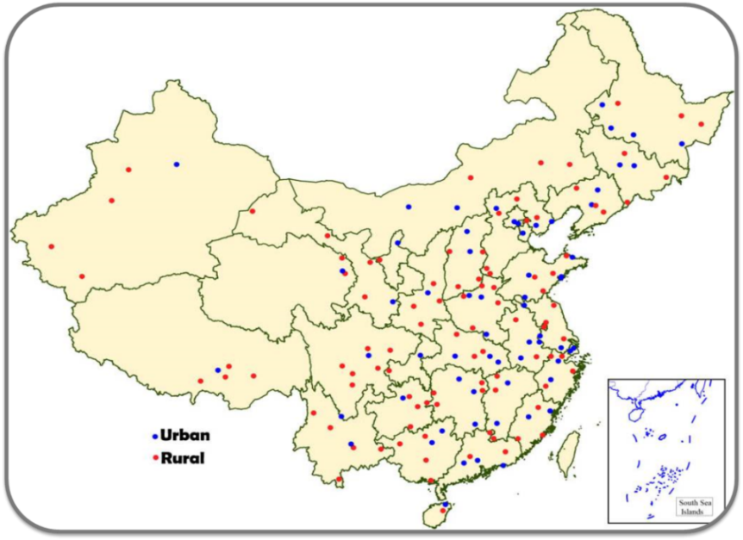
CMHS Sampling
31 provinces
157 counties (DSPs)
628 Townships
1256 villages
32552 respondents
38593 households
National representative
Multi-stage
CDC-Surveillance for Chronic Disease and Risk Factors in 2013

Slide 7
Study disorders
Mood Disorders
Anxiety Disorders
Alcohol & Drug Use Disorders
Eating Disorders
Intermittent Explosive Disorder
Sch. & Psychotic Disorders
Dementia
36 Subtypes

Slide 8
Instruments
Instruments | Contents
CIDI-3.0 | ICD-10/DSM-Ⅳ
 | Social and demographic data
 | WHO-DAS
 | Utilization of health service

Slide 9
Results of the CMHS
12537 male and 15603 female respondents, about 88% Han Chinese, completed the survey between July 22, 2013, and March 5, 2015.

Slide 10
Results of the CMHS
Lifetime and 12-month prevalence of any depressive disorders were higher in women than men (OR: 1.44, 95%CI: 1.20-1.72 and OR: 1.41, 95%CI: 1.12-1.78), in unemployed persons than persons who were employed (OR:2.38, 95%CI: 1.68-3.38; OR: 2.80 95%CI: 1.88-4.18), and in people who were separated, widowed or divorced compared with those who were married or cohabiting (OR: 1.85, 95%CI: 1.40-2.46 and OR: 1.87, 95%CI: 1.39-2.51).

Slide 11
Prevalence of Depressive Disorder（%）

Slide 12
Prevalence of Depressive Disorder by Age and Sex (%)

Slide 13
Prevalence of Depressive Disorder by Marrage and Employment (%)

Slide 14
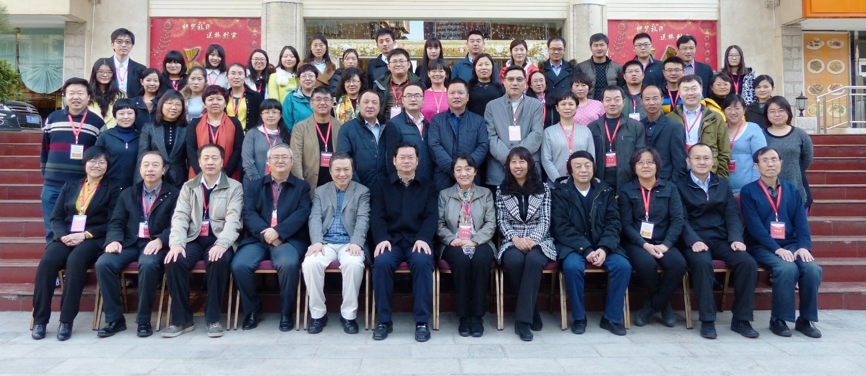
Conclusion
Depressive disorders in China were more prevalent among women, unemployed persons and those who were separated, widowed, or divorced.

Slide 15
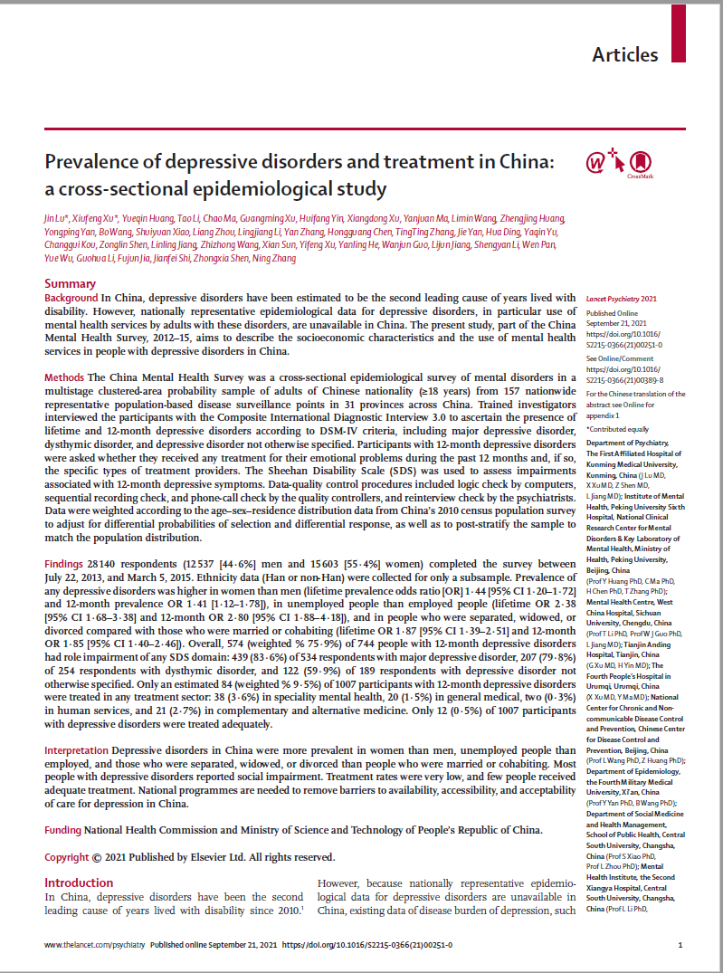

Published on Septmber 21, 2021 in Lancet Psychiatry

Slide 16
Thank you

